Slide 1
128-bit AES using verilog

Slide 2


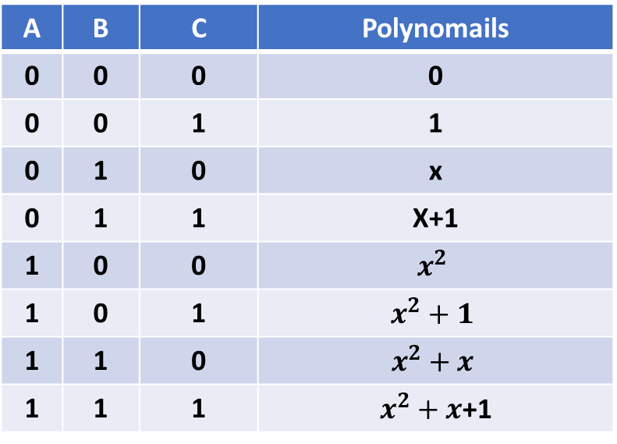
Galois Finite GF($p^{m}$)
Used to present polynomials function in binary format.
Ex: $GF\left(2^{3}\right):$ it is a finite field that contains the following polynomails:
A | B | C | Polynomails
0 | 0 | 0 | 0
0 | 0 | 1 | 1
0 | 1 | 0 | x
0 | 1 | 1 | X+1
1 | 0 | 0 | $$x^{2}$$
1 | 0 | 1 | $$x^{2}+1$$
1 | 1 | 0 | $$x^{2}+x$$
1 | 1 | 1 | $x^{2}+x$+1

Slide 3
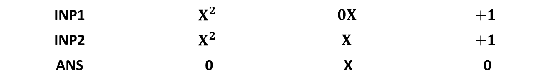

Galois Finite GF($2^{m}$)
Addition:
Ex:
INP1 | $$X^{2}$$ | $$0X$$ | $$+1$$
INP2 | $$X^{2}$$ | $$X$$ | $$+1$$
ANS | 0 | X | 0

Slide 4
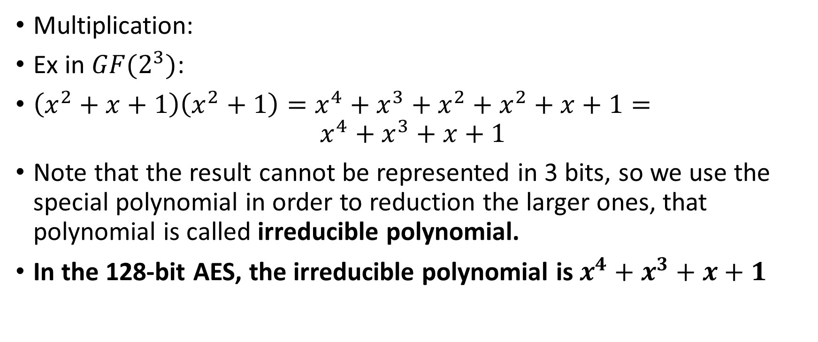
Galois Finite GF($2^{m}$)
Multiplication:
Ex in $GF(2^{3})$:
$\left(x^{2}+x+1\right)\left(x^{2}+1\right)=x^{4}+x^{3}+x^{2}+x^{2}+x+1=$
$$x^{4}+x^{3}+x+1$$
Note that the result cannot be represented in 3 bits, so we use the special polynomial in order to reduction the larger ones, that polynomial is called irreducible polynomial.
In the 128-bit AES, the irreducible polynomial is $x^{4}+x^{3}+x+1$

Slide 5
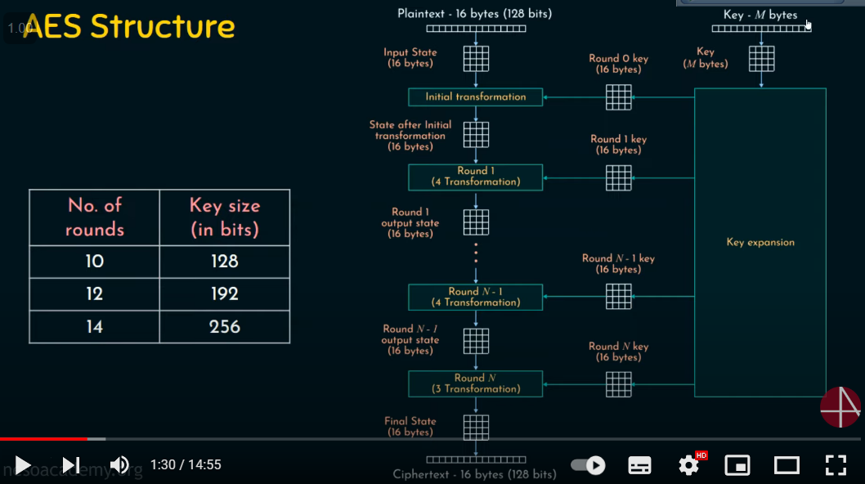
AES structure

Slide 6
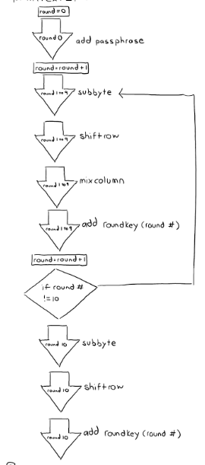
AES flowchart:
The last round doesn’t have mix columns function.
128-bit AES needs 10 rounds in addition to the initial round.

Slide 7
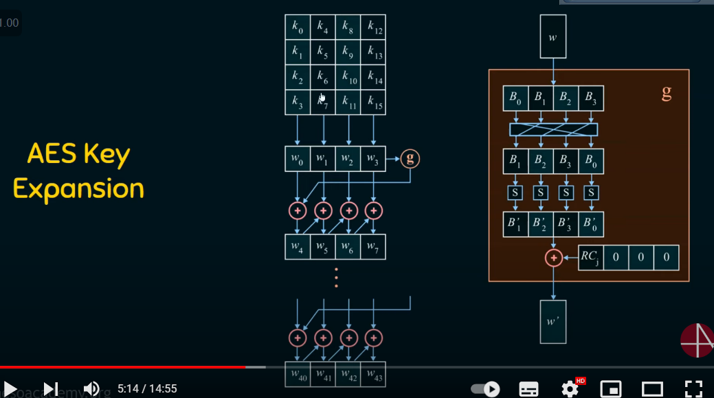
Key expansion structure:

Slide 8
Repetitive block in Key expansion :
W[
W[3]
W[4]
W[5]
W[6]
W[7]
G
+
+
+
+
W[0]
W[1]
W[2]
W[3]

Slide 9
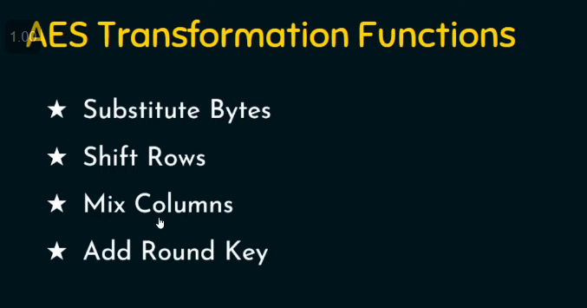
AES transformation functions

Slide 10
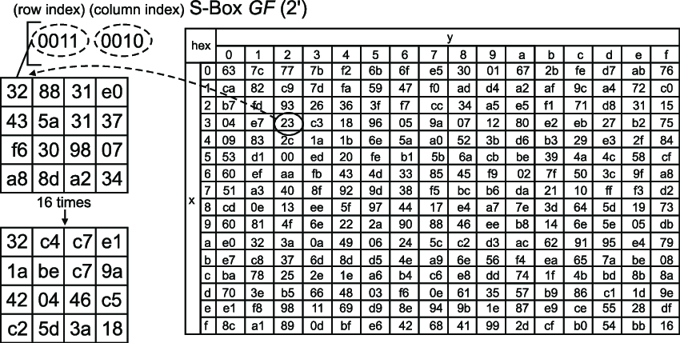
Substitution function (LUT):

Slide 11
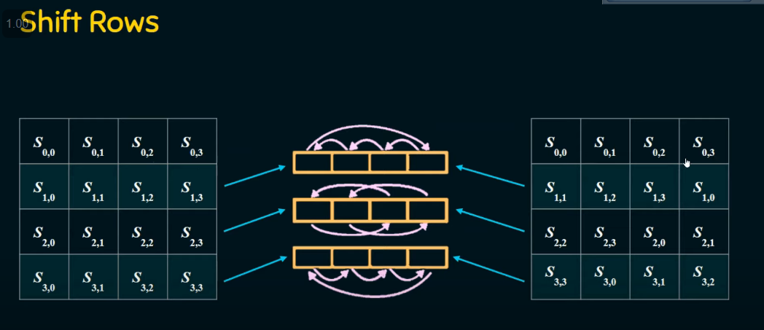
Shift rows funtions:

Slide 12
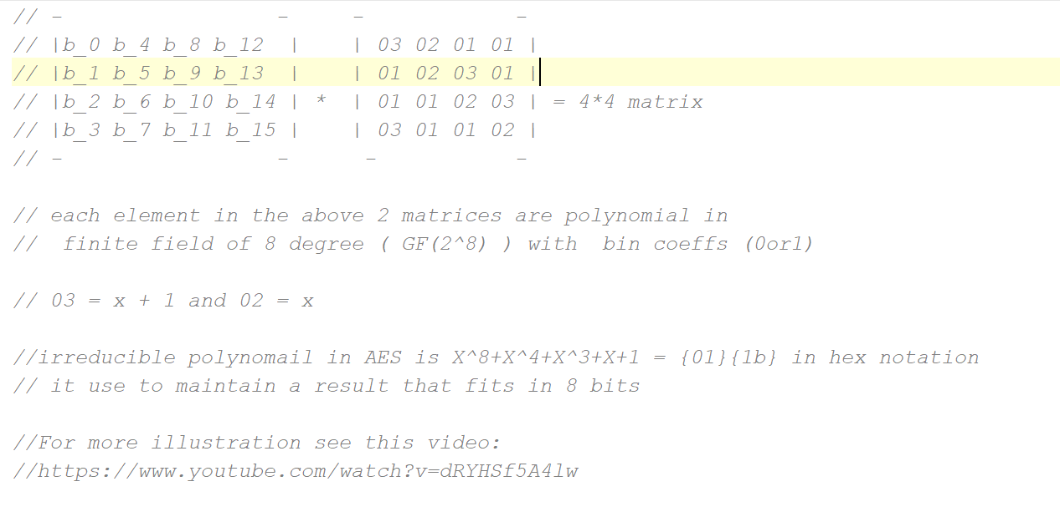
Mix_columns function notes

